Slide 1
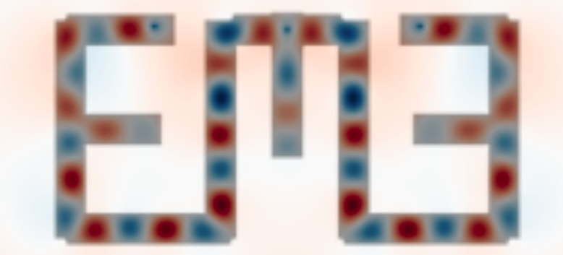
Machine Learning in Photonics:
Py
Ian Hammond, Alec Hammond

Slide 2
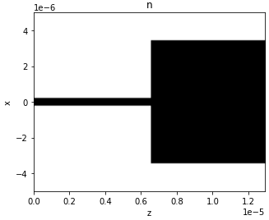
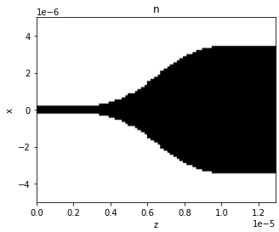
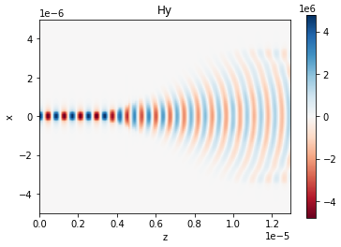
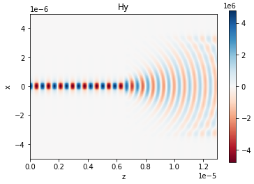
EME Overview
Photonic Crystal EME with PML
Dielectric Waveguide EME
EME Advanced Boundary Conditions

Slide 3
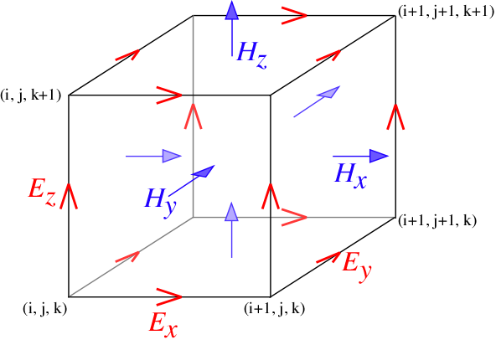
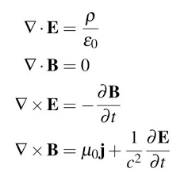
Finite Difference Overview
MEEP Yee Lattice
MEEP FDTD Paper
EMpy FD Modesolver Paper

Slide 4
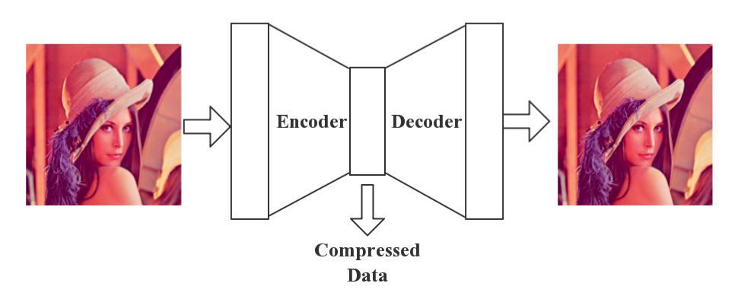
Neural Network (Convolutional Autoencoder)
Convolutional Autoencoder
MIT OpenCourseWare Neural Networks

Slide 5


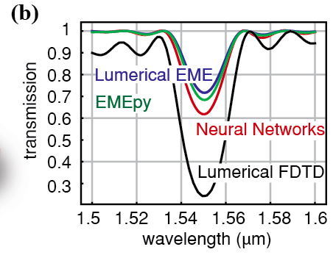
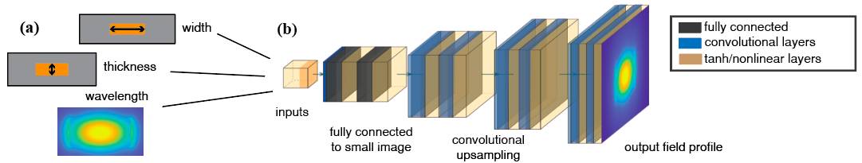
EMEPy Overview
• Convolutional Neural Networks (CNN) replace Finite Difference (FD) solver
EMEPy Docs
CLEO EMEPy Paper
Optics Letters EMEPy Paper

Slide 6
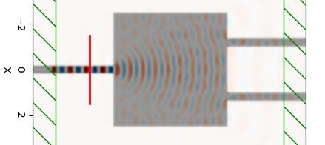

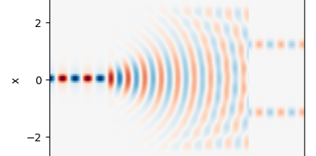

EMEPy Recent Updates
• MultiMode Field Propagation
• Recently discovered critical error!*

Slide 7


EMEPy Inverse Design
2) Phase Propagation
1) Overlap Integrals

Slide 8
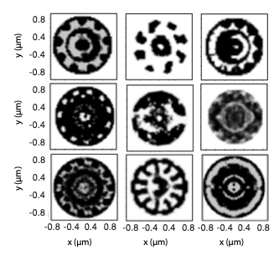
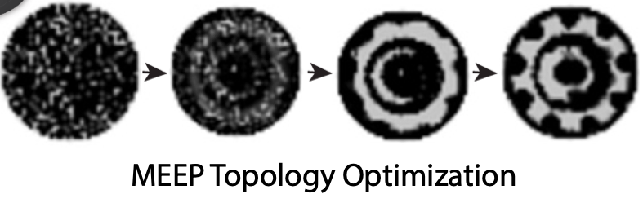
Density Based Inverse Design
• Pixel Based
• Binary material at each pixel
Quantum Emitter Topology Optimization (FiO)
Photonic TopOpt for Foundry Design
Hybrid Time/Frequency-Domain TopOpt

Slide 9
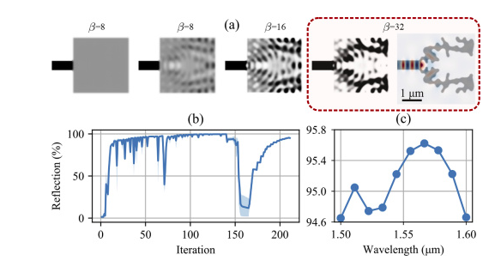
Density Based Inverse Design Broadband Robust
Quantum Emitter Topology Optimization (FiO)
Photonic TopOpt for Foundry Design
Hybrid Time/Frequency-Domain TopOpt

Slide 10
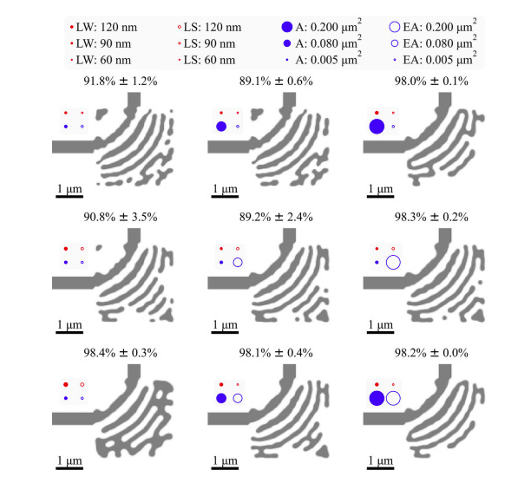
Density Based Inverse Design Foundry Robust
Quantum Emitter Topology Optimization (FiO)
Photonic TopOpt for Foundry Design
Hybrid Time/Frequency-Domain TopOpt

Slide 11
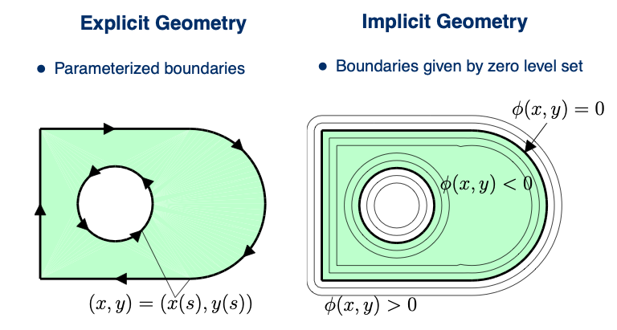
Level Set Based Inverse Design
Implicit vs Explicit Level Set

Slide 12

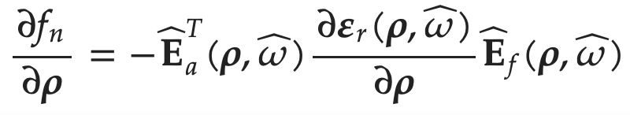
Adjoint Formulation
Lagrange Multiplier
FDTD/FDFD Adjoint
Adjoint Defined for MEEP
Stephen Johnson MIT Adjoint Notes

Slide 13
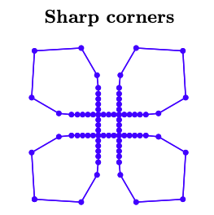
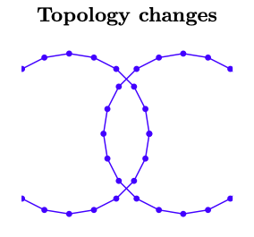

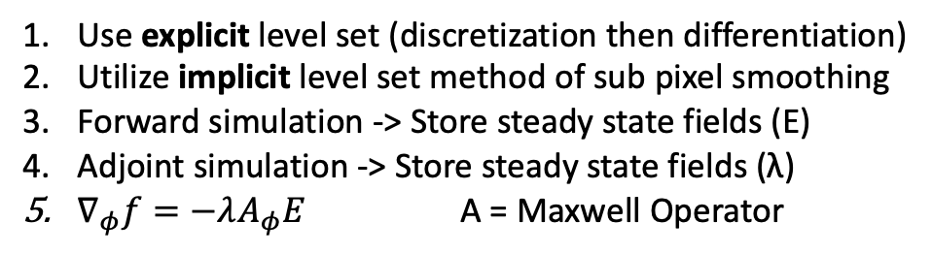
Proposed Algorithm
Use explicit level set (discretization then differentiation)
Utilize implicit level set method of sub pixel smoothing
Forward simulation -> Store steady state fields (E)
Adjoint simulation -> Store steady state fields (λ)
$∇_{φ}f=−λA_{φ}E$ A = Maxwell Operator
Fast Gradients
Subpixel Smoothing Eliminates
Explicit Level Set Allows
Adjoint Routine

